Slide 1







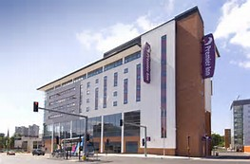

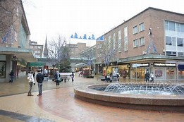

NQT welcome event 22nd September 2020
Notes:
Need some facts about Coventry
1

Slide 2

Coventry
Agenda
- Overview and welcome to Coventry
- NQT entitlements, role and responsibility
- Professional development opportunities in the city
- “Meet” the teaching unions
- Questions.
‘ Coventry City council (the Appropriate body) is committed to supporting all NQTs to complete their induction period and developing their professional knowledge and expertise’

Slide 3
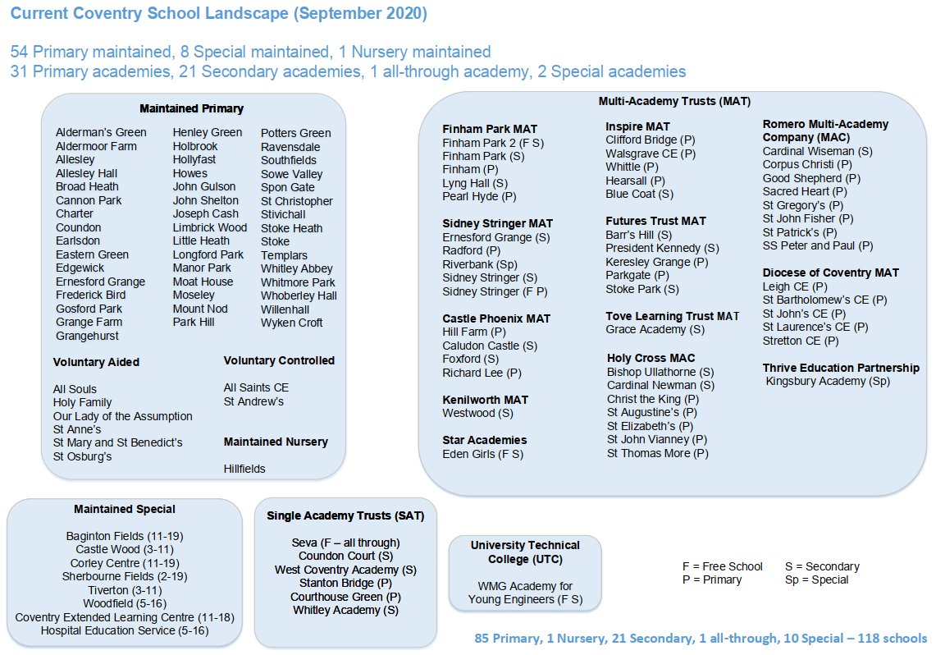

Slide 4
Coventry Education Partnership
Primary Steering and Primary Partnership
Secondary Executive and Secondary Partnership
Special Schools Network
School improvement and school-to-school support
Primary Networks x 7 (with some sub-groups)
Secondary Collaboratives x 3
Special Schools’ Network x 1

Slide 5


Induction is a statutory process;- bridge between initial teacher training a career; it provides a clear progression route into a career in teaching.
NQT’s are entitled to;-
have access to an induction tutor
a reduced timetable –
access to training and mentoring to support your career development
Notes:
The ‘school’ should not make unreasonable demands on NQT
Not normally teaching outside class or age range employed to teach in.
Not present the NQT, on a day to day basis, with discipline problems that are unreasonably demanding for the setting.
10% PPA and 10% NQT time

Slide 6

Statutory entitlements and support for NQTs; schools must
Provide NQTs with tasks, experience and support to enable them to demonstrate satisfactory performance against Teachers’ Standards
Set and review targets in relation to relevant standards and the needs and strengths of NQT’s
Provide a personalised induction programme that reflects NQT’s strengths and areas of development
Provide a termly report on NQTs progress in a formal assessment report to the Appropriate Body
‘There should be no surprises’

Slide 7
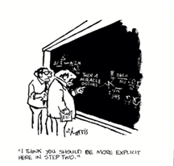
By now you should have:-
Reviewed your strengths and areas for development from ITT (CEDP) with your tutor
Received key whole school policies, for example child protection, management of behaviour, health and safety, marking and feedback policies, fire procedure
A reduced timetable 10% PPA and 10% NQT
Set dates for your observations
Agreed an individualised induction programme and targets
Notes:
Time for NQT to observe
- other teachers in own setting - in another setting where effective practice is identified
-video lessons
- ‘parrot on the shoulder’
- time to discuss findings

Slide 8


Your induction tutor has an important role in supporting your professional development;
Organising and implementing an individual programme of professional development
Ensuring that NQT’s receive appropriate support, monitoring and assessment throughout the induction year
Arranging and conducting half termly review meeting with NQTs as part of your formative assessment and providing regular well founded feedback to the NQTs on their progress
Making formal observations of teaching at least once every half term and providing accurate and constructive feedback
Maintaining a written record of support, monitoring and assessment

Slide 9
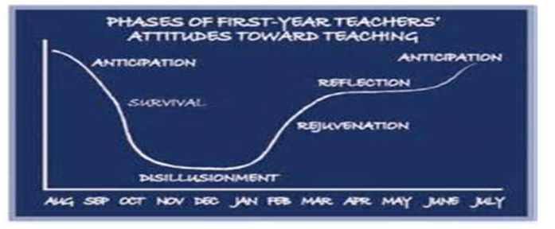
NQT role;-
Meet with induction tutor to discuss and agree priorities and keep these under review.
Raise any concerns with induction tutor as soon as practicable and communicate with colleagues
Consult the ‘appropriate body’ at an early stage if there are any difficulties in resolving issues with their tutor
Provide evidence of progress against the standards
Notes:
Records of observations and professional review meetings
Self assessment by the NQT
Analysis of pupils’ work & assessment records – both formal & informal
Samples of planning & lesson evaluations
Liaison with colleagues, parents
Examples of standards that need more consolidation
In most cases it will not be necessary to collect large amounts of supporting evidence for the 8 Standards
More helpful to select specific pieces of evidence that arise from day to day work & planning
Evidence to support termly assessments

Slide 10


What the school expects; that you enjoy your first year of teaching!!
You become an effective teacher and that work is planned and marked
You implement school policies and practices and maintain positive standards of behaviour
You increasingly contribute to school life and have high standards of conduct and punctuality

Slide 11


NQT assessment reports must provide a clear a judgment of NQTs progress against the standard by;-
Providing information on an NQT’s strengths and areas of development or where improvements are required against specific standards.
First and second reports show an assessment of an NQT’s performance at the end of these induction periods and make a recommendation about NQT’s rate of progress towards the final induction period.
Final assessment recommends that whether (or not) the NQT’s performance against the standards is satisfactory, unsatisfactory or whether an extension should be granted

Slide 12
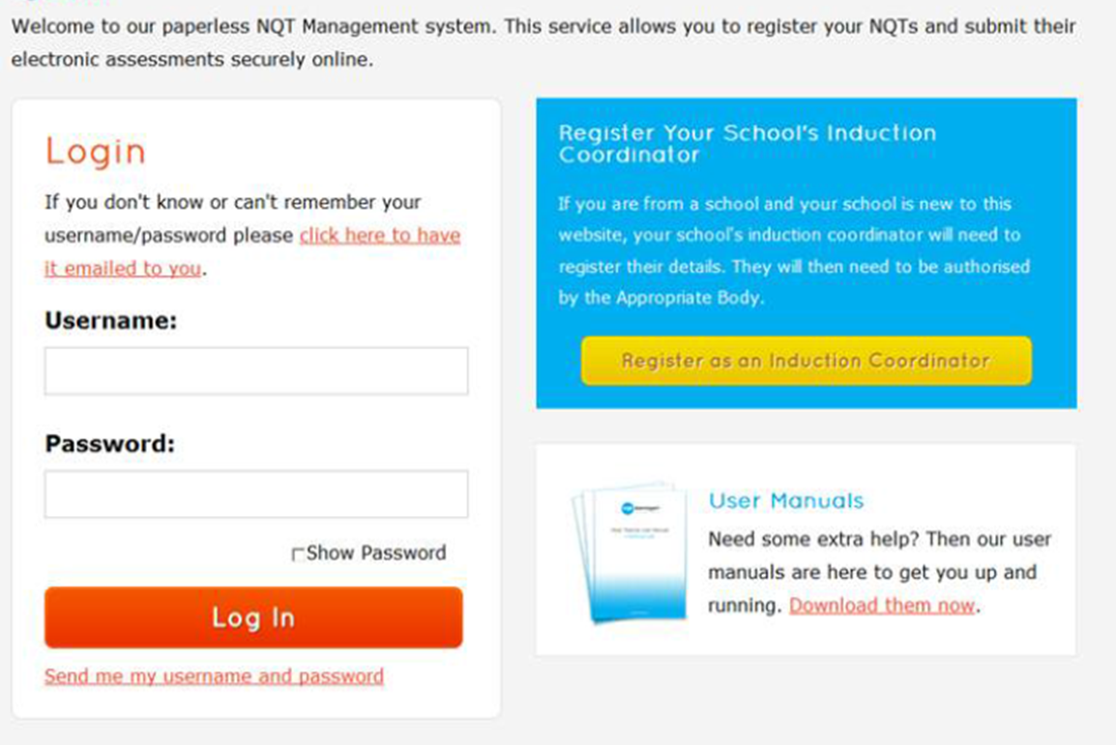
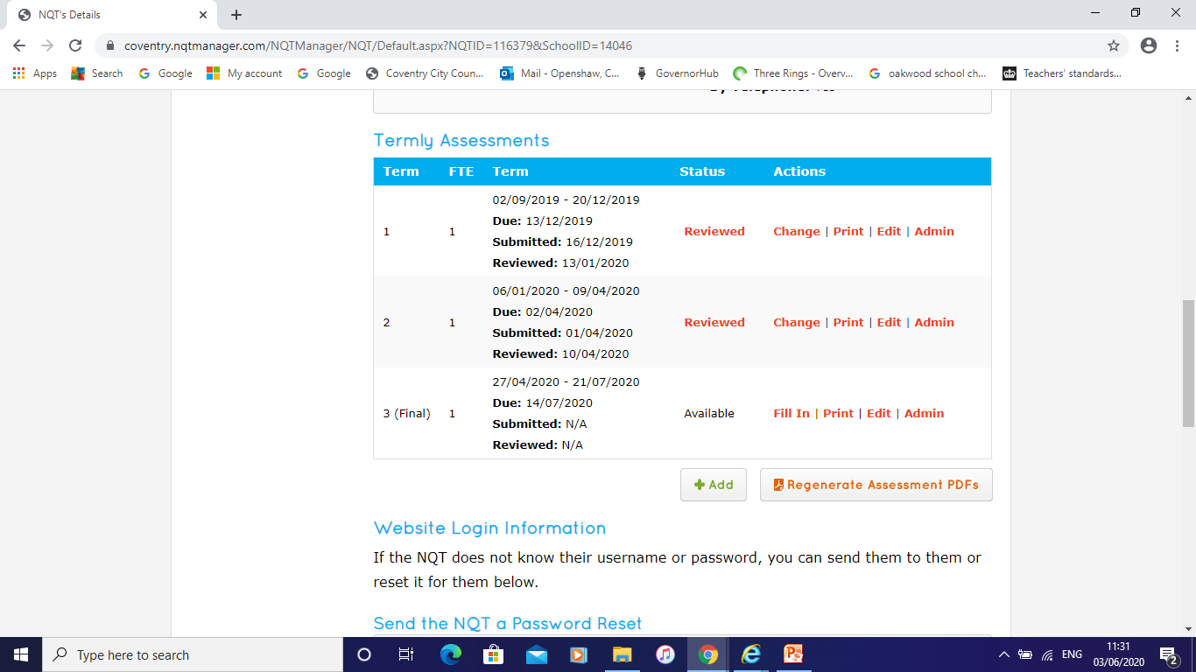
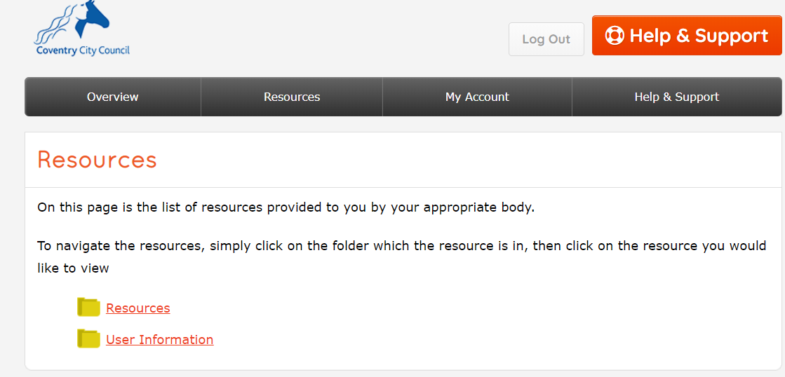
Registering

Slide 13
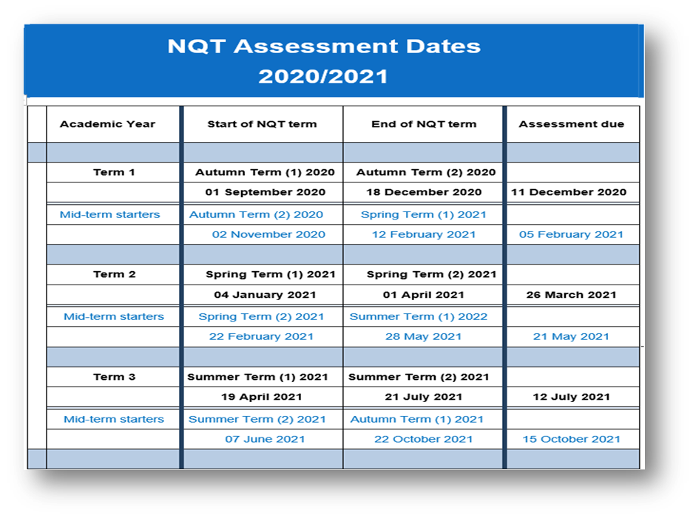

Slide 14

Workforce Development Offer
The Coventry Teaching Schools Collaborative brings the Teaching Schools in Coventry together to provide professional development with the aim of inspiring excellent practice.
The collaboration includes: Blue Sky, Castle Phoenix, Inclusive, The Lion, President Kennedy, and The Swan Teaching School Alliances.
An electronic booklet will be distributed that provides a summary of the packages available to all schools and academies for 2020/21.
Coventry Teaching Schools Collaborative: Inspiring Change in Education
20% off recommended courses for NQT's
Notes:
This training offer has been produced between a group of Teaching Schools in Coventry to provide access to training for NQT's and those in the early stages of their career. You can book on to any course via the training brochure which will be sent out after the session today. NQT's who are undertaking their NQT year with Coventry as the appropriate body can get 20% off any of the courses that are recommended for NQT's in the training brochure.
The benefits of accessing this teaching school led NQT /RQT programme is a delivery team who have local knowledge, combined with expertise, gained in the delivery of day to day practice in Coventry Schools. This ensures a professional development offer which is good quality, responsive and highly relevant.
Well-being, resilience and managing workload are a common thread throughout this programme, ensuring that this offer is responsive to needs and based on honest and reciprocal relationships.
Our commitment is to:
Strengthen system leadership in the city to complement established primary and secondary network activity and to promote outstanding practice through schools sharing their strengths and through benefiting from best practice regionally and nationally.
Provide a cost-effective way of sharing and developing best practice to support school improvement across the city.
Support all schools in the continued drive to improve student outcomes. Particularly, Coventry’s priority to narrow the gap with a focus on effective strategies to improve achievement of underperforming groups
Focus on high quality teaching and learning and approaches for continued and sustained improvement of teaching, learning and student achievement.
We look forward to welcoming your staff and working together over the coming year.

Slide 15
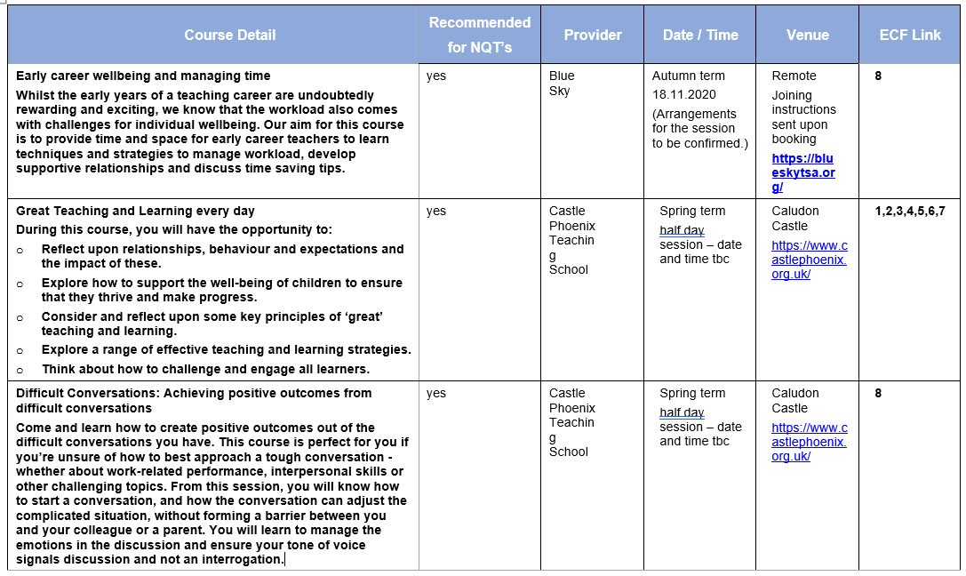
NQT & RQT Professional Development Programme 2020 – 2021

Slide 16
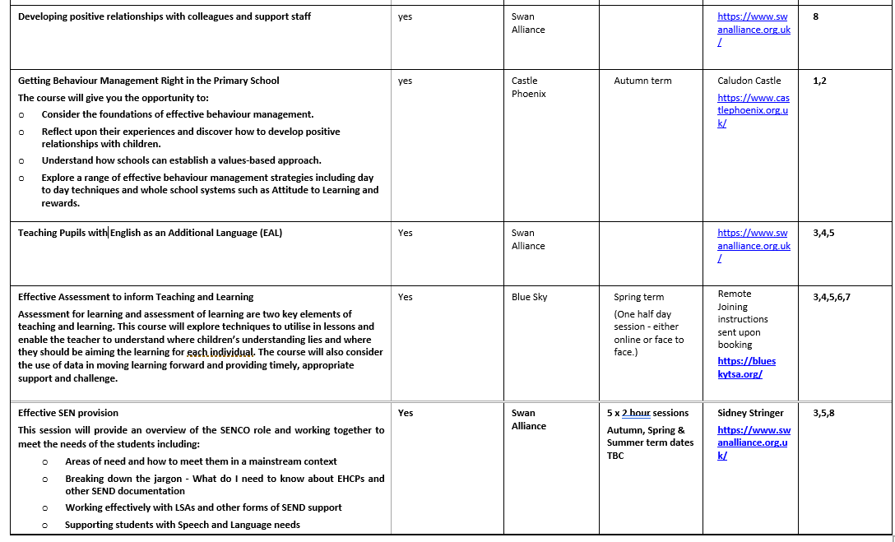

Slide 17
NEU
District Secretary: Nicky.Downes@neu.org.uk
District Secretary: christopher.denson@neu.org.uk
Coventry office tel: 024 7667 0182
coventrydistrict@neu.org.uk

Slide 18
NASUWT
Pippa Richings, Nigel Buckler & Manjinder Bhandal
Tel: 024 7669 1022
nasuwtcoventry@hotmail.co.uk

Slide 19





Role of the Appropriate Body
Notes:
Role of the Appropriate Body within NQT induction;-
Quality assures role the induction process
Reviews assessments for each induction period
Reports outcomes to the Teacher Regulation Agency
Named person for you to raise any concerns
Role of the Appropriate Body within NQT induction;-
Quality assures role the induction process
Reviews assessments for each induction period
Reports outcomes to the Teacher Regulation Agency
Named person for you to raise any concerns

Slide 20

Cathy.openshaw@coventry.gov.uk
LA NQT induction lead
024 7697 7022
Christine.brownbill@coventry.gov.uk
Administrative support for NQTs
024 7697 6937
www.coventry.gov.uk/nqt

